Slide 1
BIG DATA ANALYTICS – In a Nutshell
Presented by
Dr.M.SABIBULLAH,
ASSOCIATE PROFESSOR,
PG & Research Dept. of Computer Science,
Jamal Mohamed College (Autonomous),
Trichy-620020.
Date: 04.08.2022

Slide 2
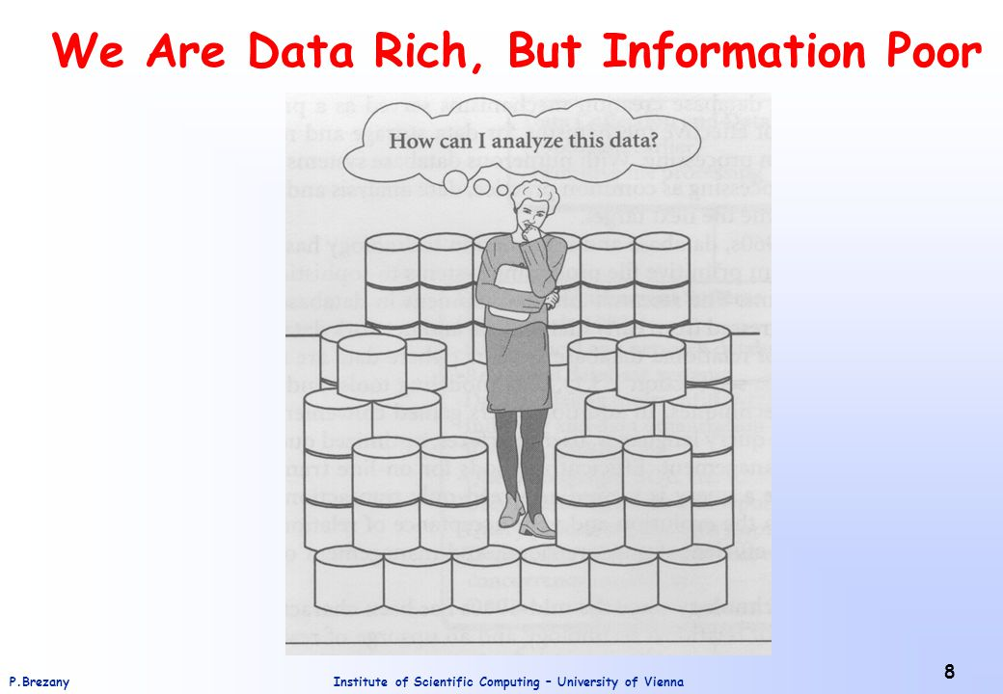
PRESENT SCENARIO
IT = Computer + Communication + Contents (web)

Slide 3
Inspired Slogan
“Man should think and
Machine should work “ - IBM
Present scenario is……….
“Man should work and
Machine should think” - SABIBULLAH
i.e., To Create a Best Learning Machine

Slide 4
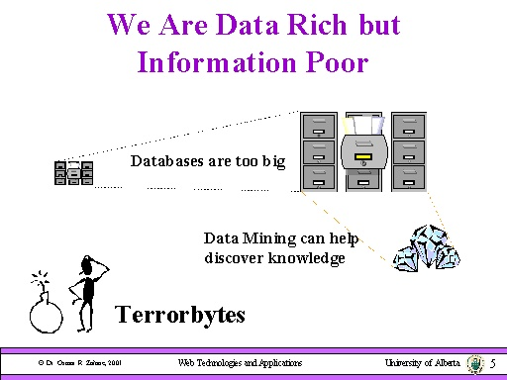
Terabytes (Or) Terrorbytes ?

Slide 5
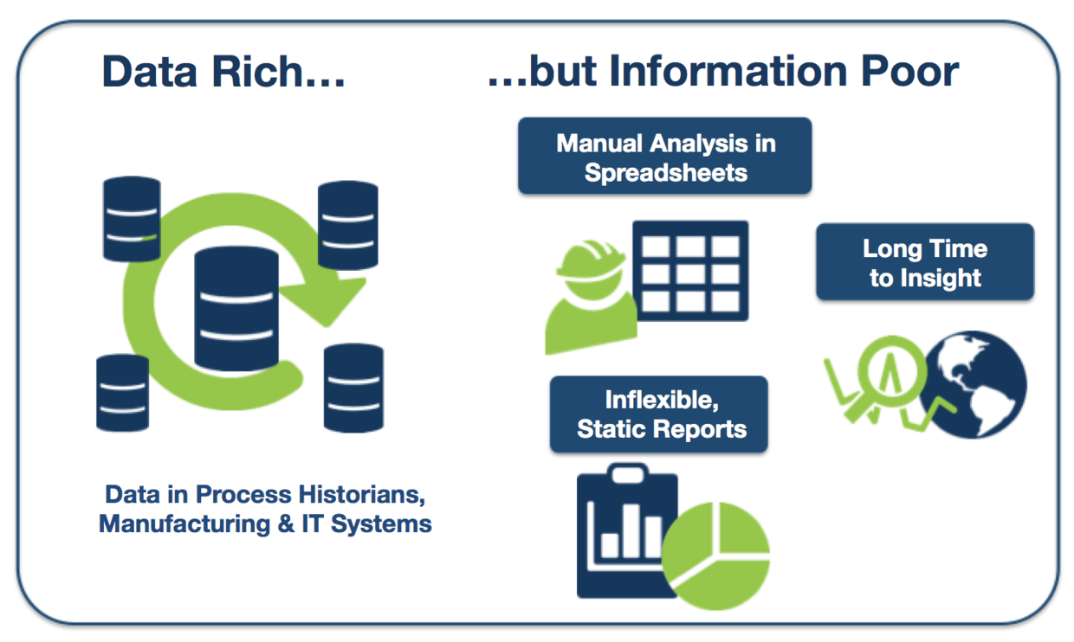

Slide 6
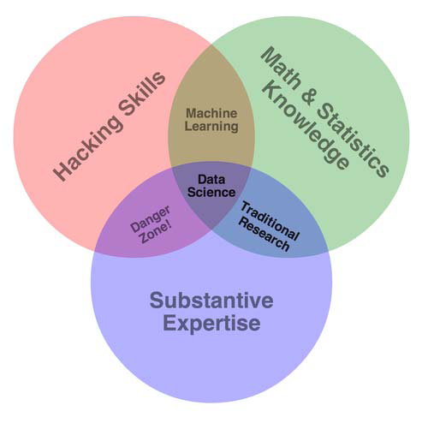
Data Science
Data Science combines the traditional scientific methods with the ability to crunch, explore, learn and gain deep insight for Big Data.
Evolution of streaming data, there will be an increasing demand for Big Data Analytics (BDA) in. Data Science Age.
World’s data volume is expected to grow 40% per year, and 50 times by 2020.

Slide 7

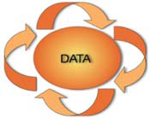
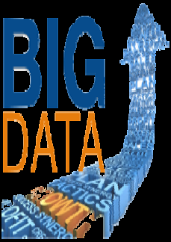
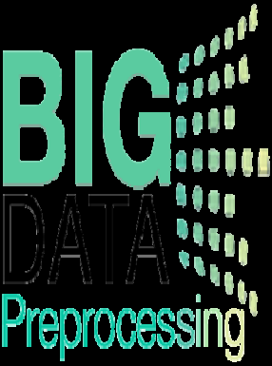
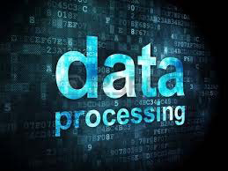

Data Science Process
Data Preprocessing: Data [Clean, Integration, Transformation, Aggregate,
Reduction] Imperfect Data: Missing, Noisy etc., Reduce Dimensionality….
Data Processing: Explore, Represent, Link, Learn from Data, Deliver insights….
Data Analytics: Classification, Clustering, Regression, DT, Association, Visual Analytics etc.,
Evolution: DBMS-based (Structured Content) → Web-based (Unstructured
Content) → Mobile and Sensor based Content

Slide 8
Analytics Technology
Analytics: It is a Real-world use of Big Data
[How innovative enterprises extract value from uncertain data]
Analytics (“Data Analytics”) refers to the organized computational analysis to transform
Data → into → Information and Knowledge
called “Data-driven decision-making”.
Aim is to discover data collected from different sources and analyze those data to reach-out an optimal decision.

Slide 9
Data Analytics
Data Analytics (DA) is the science of examining raw data with the purpose of drawing conclusions about that information.
DA are used in industries to make better business decisions and in the sciences to verify or disprove existing models or theories.
It can be greatly used to improvise the healthcare sector by effective cost management, improved, timely and effective treatment.
Big Data Analytics (BDA) has emerged as an Advance Analytical Technology where large-scale and multifaceted data are processed under specific analytical methods.

Slide 10
BD Process
Data is everywhere and it is everything within the universe. It means that data is within the existing limitation of technological capacity.
BD Process:
Data → Types of Data → Data Quality → Data Analysis
BD Analysis → BD Analysis Techniques [By ML]→
BD Technologies / Tools → Analytics (Data Analytics)
→ Type of Analytics.
Pure data-driven analysis may add little value for a decision maker.

Slide 11
Big Data → Meaning
1) Collecting large amounts of data Via computers, sensors, people, events …
2)Doing something (Beneficial) with it; Making decisions, confirming hypotheses, gaining insights, predicting future …
Ability to collect data will only increase
Ability to analyze data will only improve
“Data Science” = Going from (1) to (2)

Slide 12
Core Knowledge to Understand BD & Analytics
Composite skills to be required to understand;
  Programming - Data oriented tools e.g., SQL
  Statistics - Working knowledge to apply techniques
  Domain Knowledge - Understanding the Problem domain
  Communication - Able to understand needs of people &
  organizations and ARTICULATE results
  to deliver them.

Slide 13
Popular BD - Definitions
BD as Technology: New technology development like MR, RDD in Spark, Flink in Lambda Architecture.
BD as Application: Different applications based on different types of BD (It looks for hindsight of data).
BD as Signals: Focuses timing rather than type of data.
BD as Opportunity: Highlights many potential opportunities by revisiting the collected or archived datasets when new technologies are variable.
  (i.e., data that was previously ignored because of technology limitations
BD as Metaphor: It elevates BDA to the new level. Defines Big Data as human thinking process.
Big Data as New Term for Old Stuff: Means the new bottle for old wine (BI, DM or other traditional data analytic activities).

Slide 14
Motivation Behind Big Data
The purpose of doing Big Data or BDA is to gain;
  Hindsight - metadata patterns emerging from historical data
  Insight - deep understanding of issues or problems
  Foresight - accurate prediction in near future
        in a cost-effective manner.

Slide 15
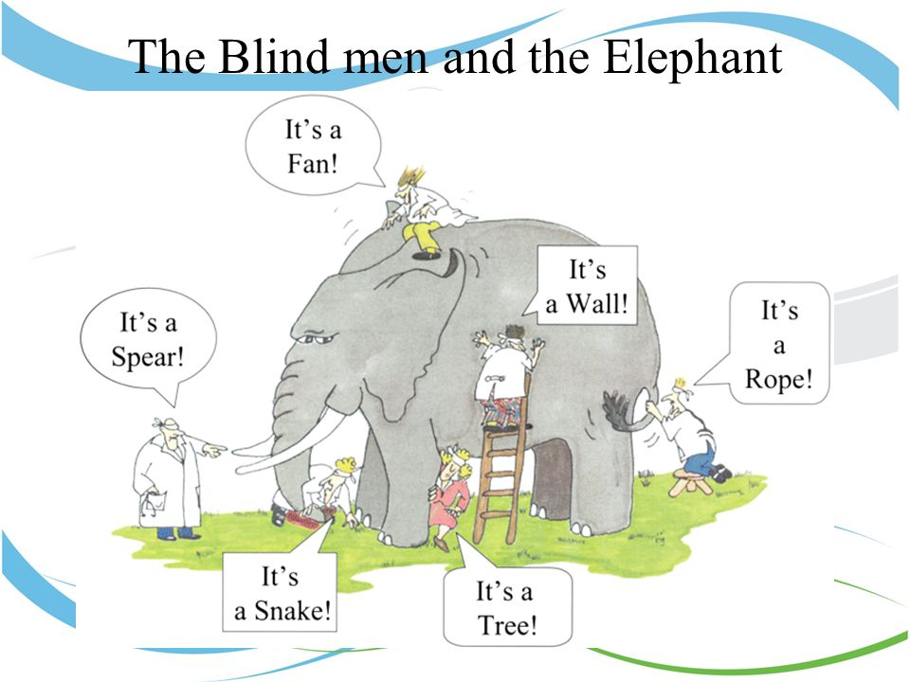
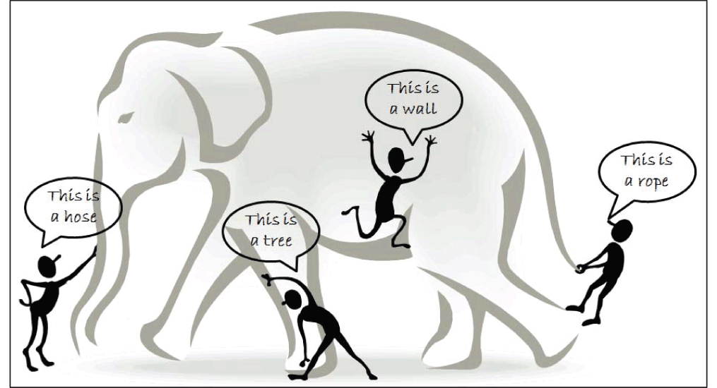
Big Data- Six Blind Men & Giant Elephant
[Limited view of each blind man leads to biased conclusion]

Slide 16
BD Analytics Infrastructure
Specific Applications & Services to be required to support BD and other data-centric applications.
  Cluster Services
  Hadoop related services and tools
  Data analytics tools (logs, events, DM etc., )
  Databases/ Servers: SQL, NOSQL (Not Only SQL)
  MPP (Massively Parallel Processing) Databases
  Services on BDA tools offered by major Cloud Service Providers: Amazon
  Elastic, Dynamo, MS Azure HDInsight, and IBM BDA
  Services on Scalable Hadoop and Data analytics tools and services by:
  Cloudera

Slide 17
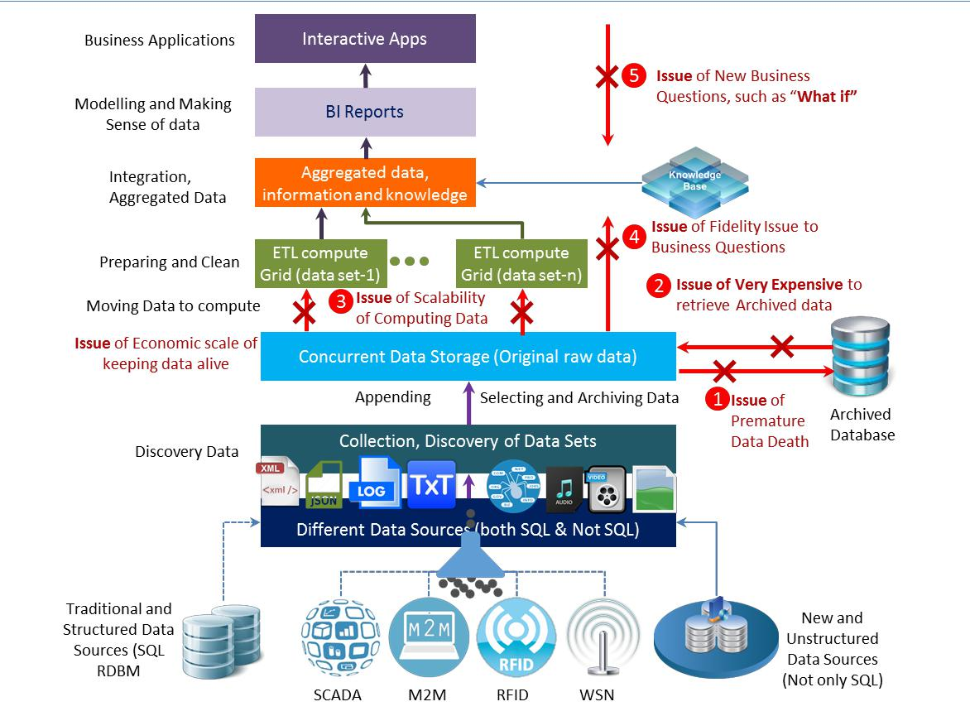
Key Motivations of BD Analytics

Slide 18
Data-Intensive Technology
Big Data Technology is a concepts of big data, data-intensive computing through machine learning or a path for discovering patterns and exploration of hidden patterns.
It provides a powerful infrastructure for gradual information from the ocean of dissimilar sources generated by machine and human.
BD can formulate methods of handling massive data, provide parallel and real time supported computing, data management tools to deal with huge and complex datasets.
Higher-level scalable data processing libraries.

Slide 19
BD Analytics
Big data Analytics helps to identify new opportunities by harnessing the data.
Big Data analytics can be inferred and described.
Challenging task in analytics of BD to unite data in a maximum values, called BD Analytics.
Many open source technologies used for handling massive data volumes by distributing data storage and computations across a cluster of computers.
Importance on Analytics: It is not only restricted to business applications, but also have wide usage in other applications like education, medical, entertainment, finance, marketing, communication, politics etc.

Slide 20
BD Analytics & Services
Big Data Analytics has become one of the most discussed topics among researchers for further research direction.
Big data analytics focuses on data science and predictive analysis to be performed on large scale data sets.
Big data analytics systems as emerging technologies which are made possible by the remarkable progress in the healthcare systems.
Big data analytics & services : It can monitor and detect vital
signs and other various measurements which can be provided to physicians or healthcare providers to support them in the diagnosis process.
It can significantly contribute towards improving the efficiency and effectiveness of healthcare services.

Slide 21
BD Stack / Phases - To discover patterns
It is important to understand the entire stack so as to address certain aspects to the specific problem to be prepared for the future.
Big data analytics defines the following process to discover patterns and devise other useful information;
    Collecting (Capturing)
    Organizing (Storing)
    Summarizing (Sharing)
    Analyzing
    Synthesizing (Searching)
    Decision Making (Decision support-to act)

Slide 22
Principle of Computational Processing
Big Data Analysis can be applied to special types of data.
Many traditional techniques for data analysis may still be used to process Big Data. Most of methods are related to statistics and computer science.
Prior to data analysis, data must be well constructed.
Understanding the method by which data can be preprocessed is important to improve data quality and the analysis results.
Principle of Computational Processing :
← Bring computer to data rather than bring data to computer .
Philosophy of computation :
→ Divide and Conquer (i.e., Data Partitioning) for large datasets
Initiators : Doug Cutting and Michael J Cafarella
Scalability Solution: Scale-out

Slide 23
Two Sources of Data / Four BD Types
The Sources of data are divided into TWO categories:
Computer- or machine-generated: Machine-generated data generally refers to data that is created by a machine without human intervention.
Human-generated: This is data that humans, in interaction with computers, supply.
  Four Big Data Types
    Structured : Sensor data (RFID tags), Web-Log data, Point-of-sale data
    Unstructured : Satellite Images , Scientific data (Radar data), Photographs, Video
    Semi-structured : Data falls between structured & unstructured data. (eg., XML, EDI)
    Mixed : Altogether of types

Slide 24
Types of Analytics
Analytics would fetch significant outcomes / results / solutions.
Analytics solutions can be classified into FOUR levels;
    Descriptive (past history of insights)-Modeling, Model
    Estimation / Model validation
    Diagnostics (determines/discovers why something happened)
    [e.g., Identification of disease from various diagnosis report of a patient]
    Predictive (understanding the future / forecasting based on
    Available Data), Tools used: WEKA, Rapid Miner etc.,
    Prescriptive (to find possible outcomes) analytics – it Assess actions, Assist in decision-making .

Slide 25
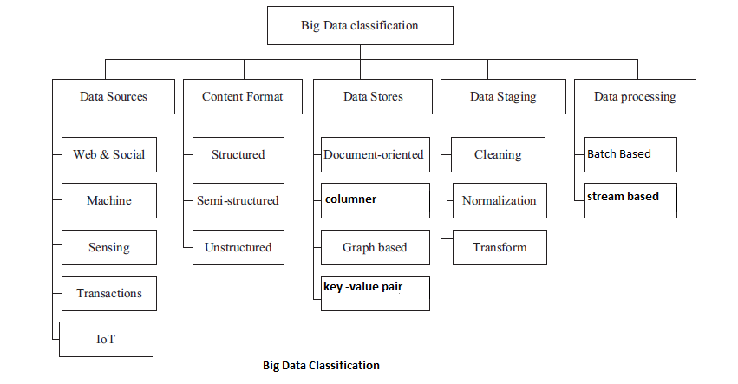
BD Data Classification

Slide 26
Different “V” Definitions
By Douglas Laney: 3 V’s (Volume, Velocity, Variety)
[Root of term traced in 2001]
By IBM: 4 V’s (Volume, Velocity, Variety, Veracity)
By Yuri Demchenko’s: 5 V’s (Volume, Velocity, Variety, Veracity,
Value)
By MS: 6 V’s (Volume, Velocity, Variety, Veracity,
Variability, Visibility)
Most of them are the data-orientated definitions but fail to articulate Big Data clearly.
In order to understand the essential meaning, we have to clarify what data is.

Slide 27
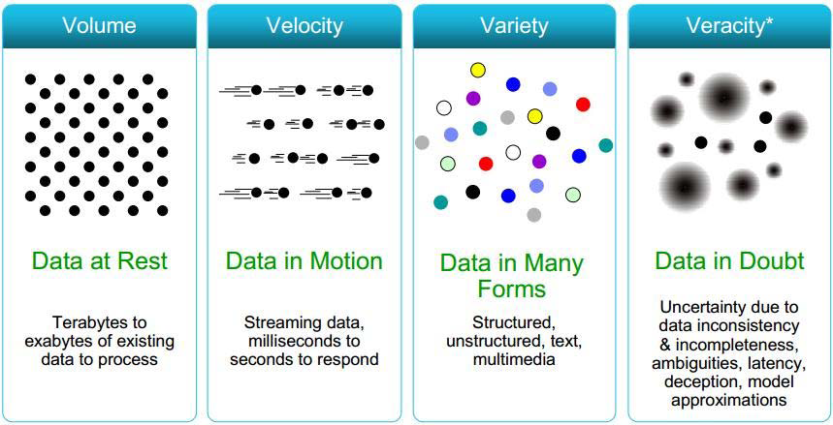
Multi “V”

Slide 28
BD Dimensions/ Characteristics/Properties = Multi “V”
Big data technologies describe the new generation of technologies and architectures designed to economically extract Value from very large Volumes of a wide Variety of data, by enabling high-Velocity capture, discovery and/or analysis .
  Data Volume - Scale of data (Data size/ Scale of Data)
  Data Velocity - Real-time high speed data / Data streams/ Data in motion / Data
  Production
  Variety of data - Heterogeneous & Unstructured data sources.
  - It measures the richness of data representation.
  (Data formats / Data Types/ Data in many forms)
  Data’s Validity - Data’s Worth / Monetary worth / Data value
  Data Veracity - To ensure Trust/ Origin / Authenticity / Uncertainty of data / data in
  doubt.

Slide 29
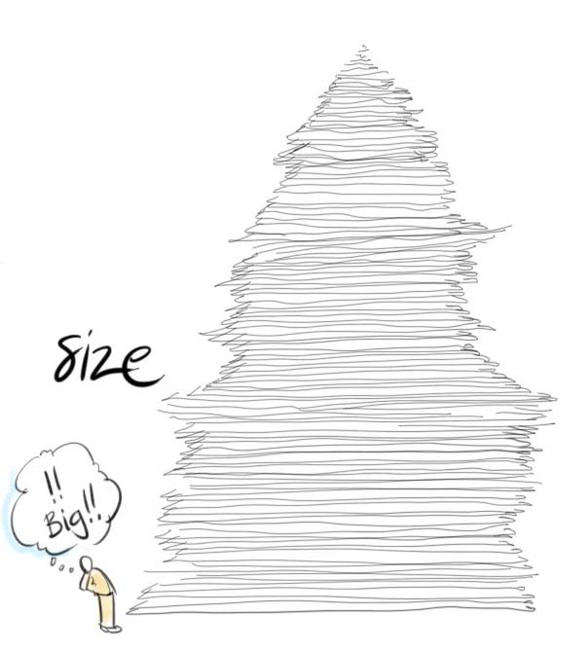
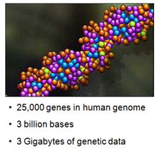
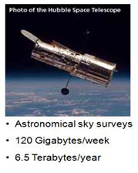

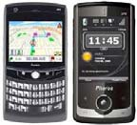
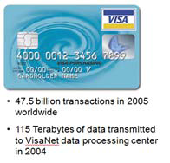

3 V’s of BD
(Eg., Genomics, Astronomy, Mobile Devices, Social Networks & Transactions)

Slide 30
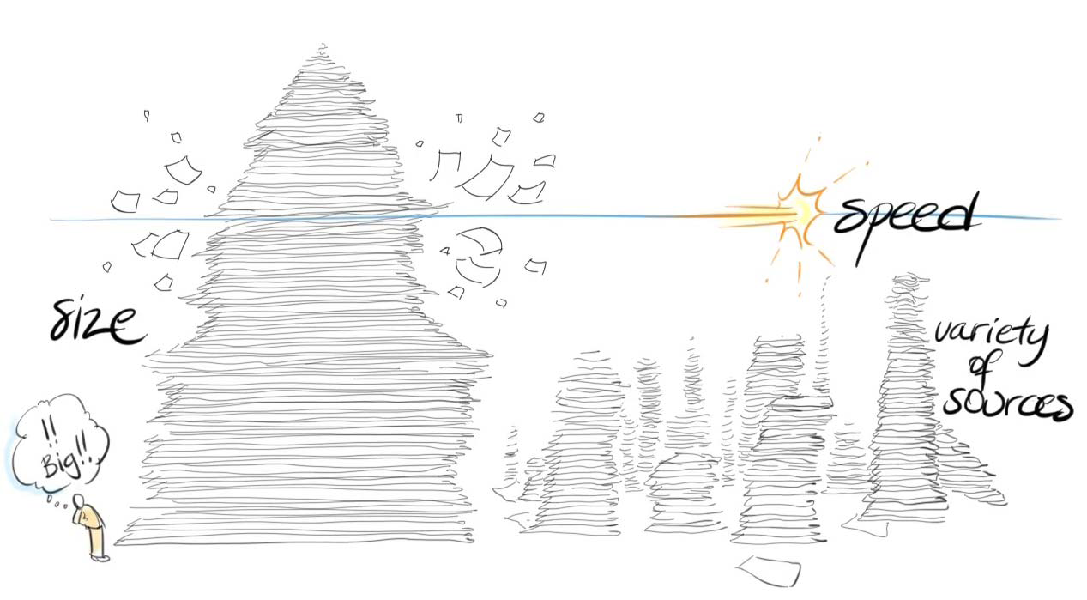
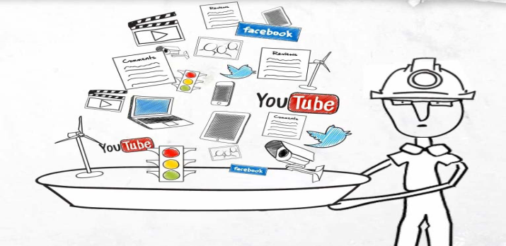
BD Sources

Slide 31
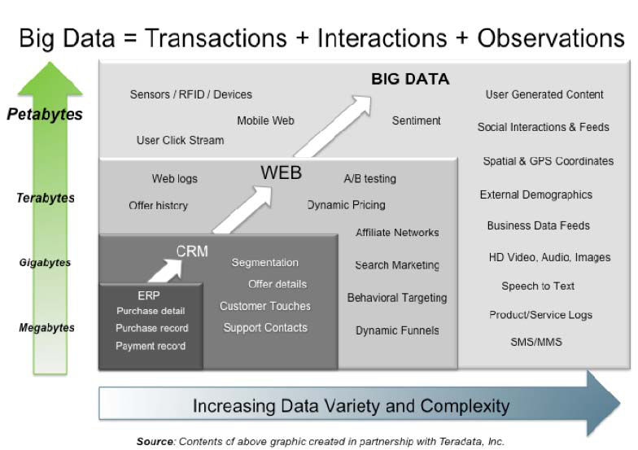
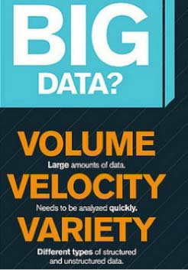
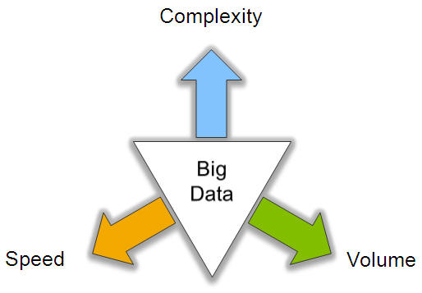
3 V’s of BD

Slide 32
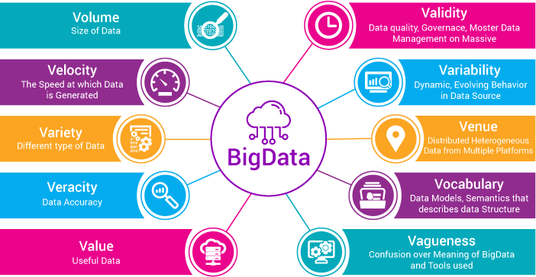
10 V’s

Slide 33
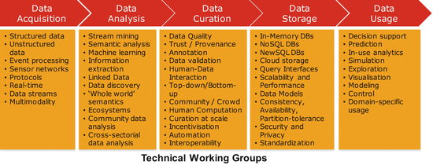
BD Value Chain

Slide 34
Processing BD Techniques
BD Process:
Data→ Types of Data → Data Quality → Analysis→ Data Analysis → BD Analysis → BD Analysis Techniques [By ML]→ BD Technologies / Tools → Analytics (Data Analytics) → Type of Analytics.
Batch Processing Technique: Huge data are collected over a period of time, processed & then produces output. It uses MR (e.g., Hadoop).
Non-Batch Processing Techniques: Involves continual input of data, processed in a smaller period of time.
Categorized by;
  Real-time processing (Thro’ In-memory computing, Real-time Queries)
  Stream processing (Thro’ Strom & S4)

Slide 35
BD Processing Technologies / Higher-level scalable Data Processing Libraries
Accessing, analyzing, securing and storing big data are one of the most alleviating technologies called big data technology.
BD Processing Technologies
  Apache Hadoop (Can perform Data-Intensive Applications)
  Apache Spark (Fast Cluster Computing)
  IBM Infosphere
  Apache S4
  RHadoop (ML Packages)
  Horton Hadoop works
  Twitter’s Storm
  Dremel by Google’s Big Query Services
  Lambda Architecture
  epiC
  Hadoop’s Core and Eco-systems potency can be considered as a “Dispensing Pipeline”.

Slide 36
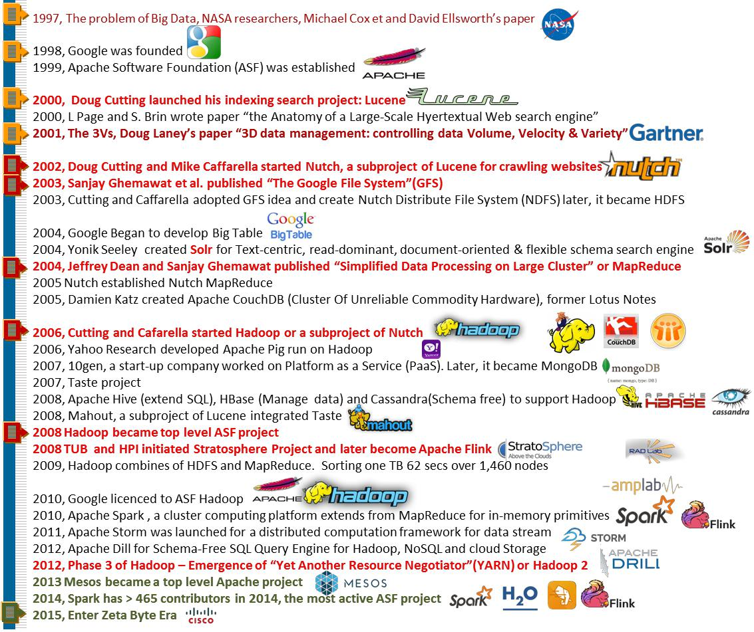
History of Big Data – An Outlook

Slide 37
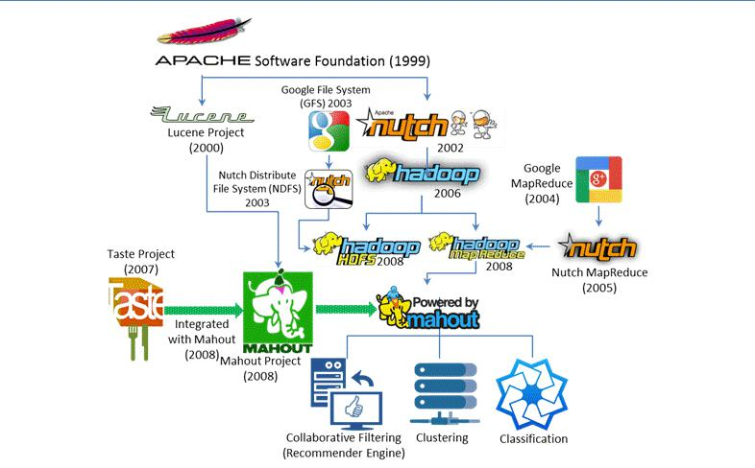
Evolution of GFS, HDFS, MapReduce and Hadoop

Slide 38
Apache Hadoop & Core Components
Apache Hadoop
    Developed by Apache Foundation
    Hadoop project adopted GFS architecture and developed HDFS
    Copies Data between Client (Local) & HDFS (Cluster)
    Heterogeneous Commodity Hardware
    Used for storing, processing, and analyzing the data
    It creates clusters of machines and coordinates work among them
  Hadoop Common
    Provides common utility and Java library functions.
Hadoop Core components
  Hadoop Distributed File System (HDFS)
    Self-healing Distributed and Shared Storage System for Hadoop.
    Rapidly distributes the data in a several nodes on a cluster.
    Provides fast performance and reliable replication of data.
  Hadoop YARN (Yet Another Resource Negotiator)
    Resource Management
  MapReduce 2.0 Architecture
    Used for parallel computations of massive datasets
Apache Mahout
    Library of Machine Learning - Supports different types of Algorithms

Slide 39

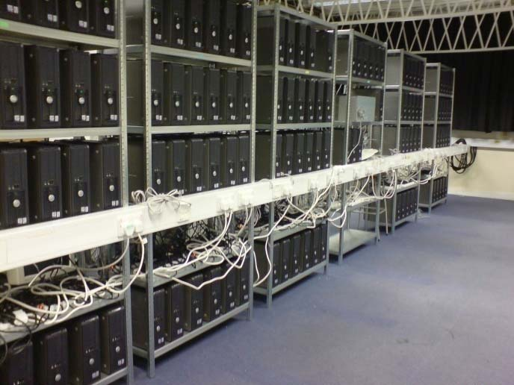

Hadoop is an open source implementation of MapReduce computational paradigm.
Apache Hadoop is an open-source software framework that supports data-intensive distributed applications, licensed under the Apache v2 license.
Created by Doug Cutting (chairman of board of directors of the Apache Software Foundation, 2010)

Slide 40
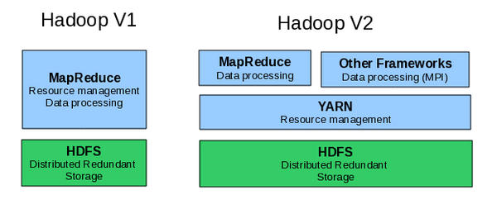
Hadoop Evolution
Map Reduce Limitations: Graph algorithms (Page Rank, Google), iterative algorithms.
Hadoop Core:

Slide 41
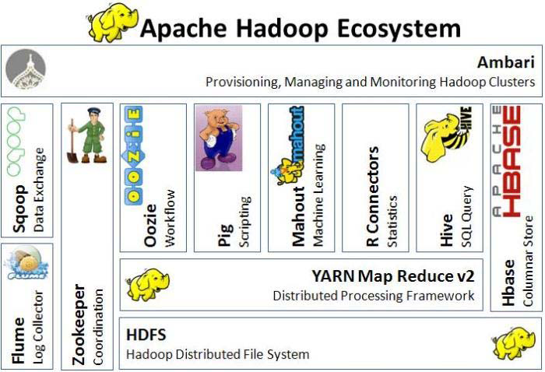
Apache Hadoop Ecosystem (Evolving) Components

Slide 42
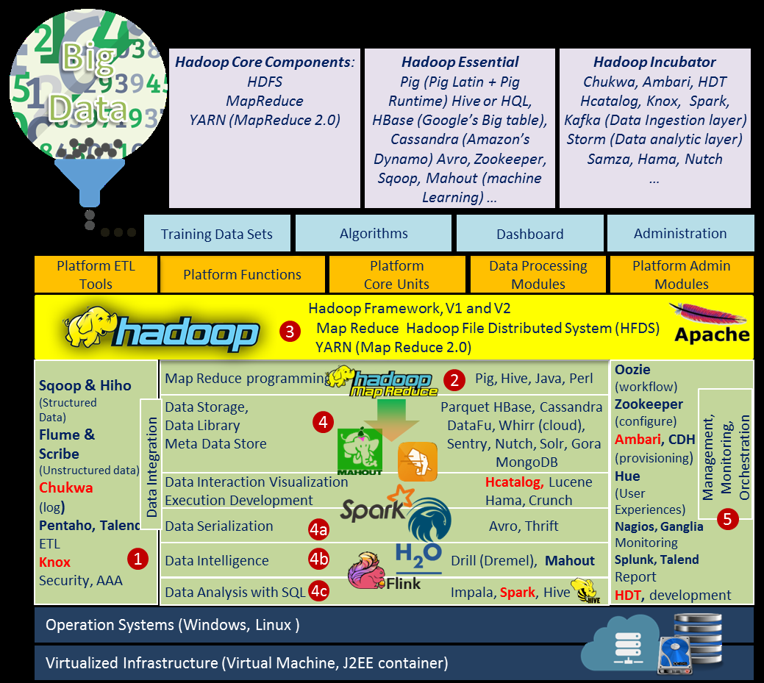
Hadoop Framework or Technology Stack & Ecosystem

Slide 43
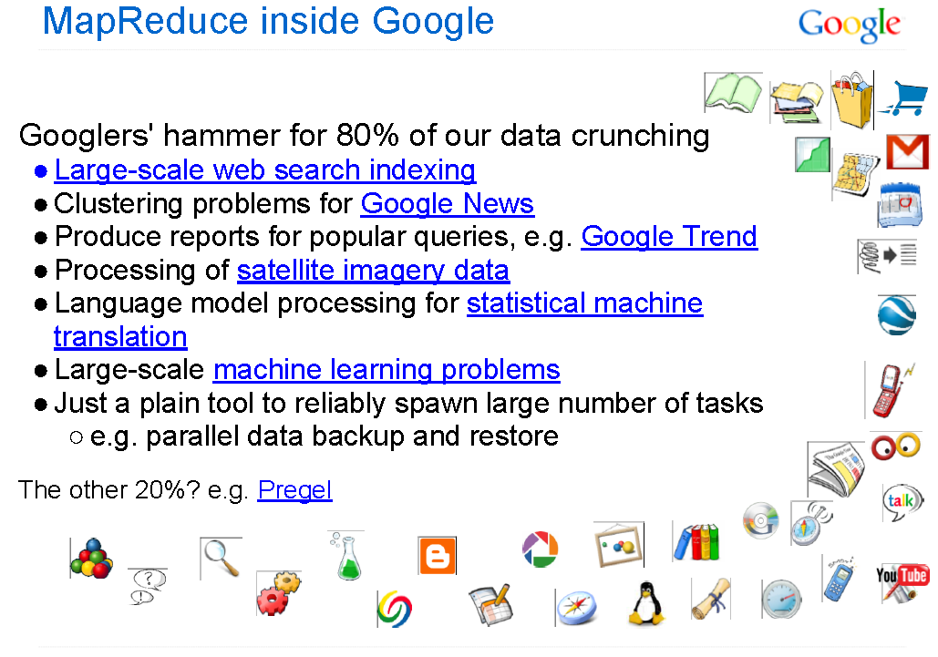
Map Reduce: More than 10000 applications in Google

Slide 44
Map Reduce
Advantage: MapReduce’s data-parallel programming model hides complexity of distribution and fault tolerance.
MapReduce (MR) = A Batch Query Processor
  Map = Distribute, Aggregate and Collaboration
  Reduce = Parallel Processing
Key philosophy:
  Make it scale, so you can throw hardware at problems.
  Make it cheap, saving hardware, programmer and administration costs (but requiring fault tolerance).
MapReduce is not suitable for all problems, but when it works, it may save you a lot of time.

Slide 45
MR Capability - Workloads
Google’s MapReduce is potentially capable to handle
FIVE types of workloads:
  Large-scale machine learning problems
  Clustering problems for the Google News and Google products
  Extraction of data used to produce reports of popular queries (e.g. Google Zeitgeist)
  Extraction of properties of web pages for new experiments and products (e.g. extraction of geographical locations from a large corpus of web pages for localized search), and
  Large-scale graph computations

Slide 46
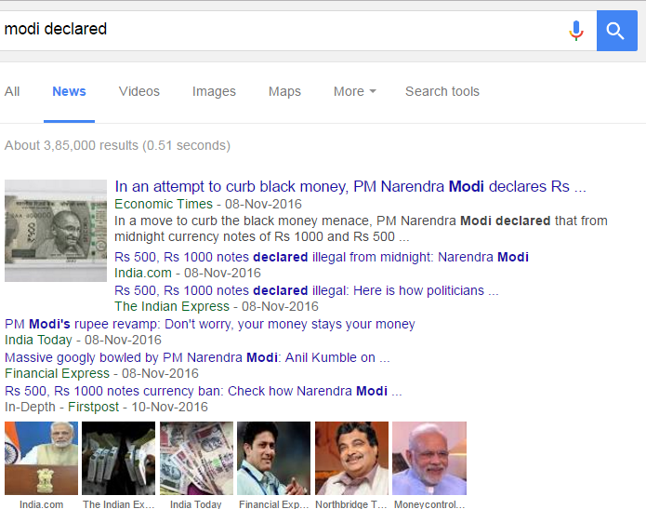
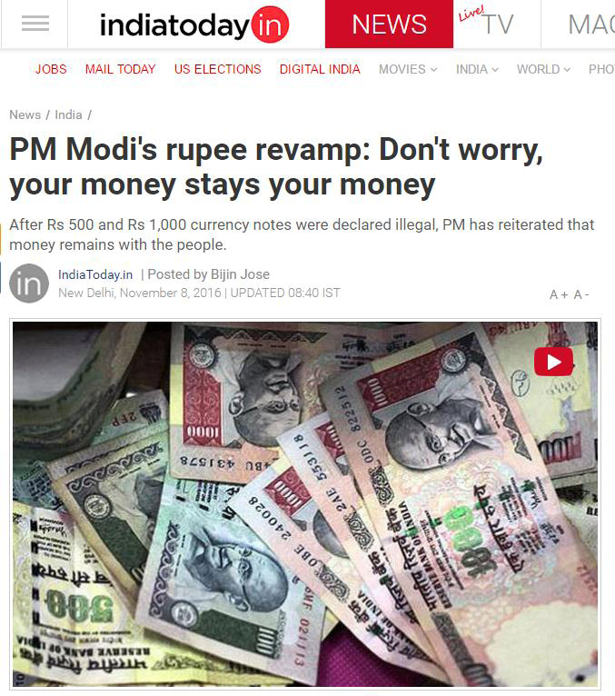
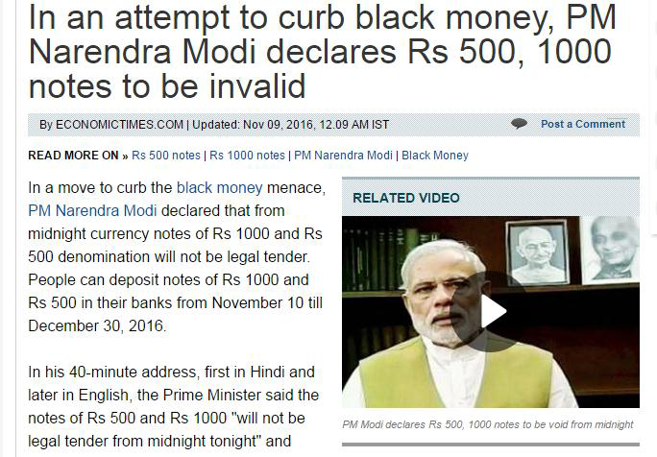
Clusters of News Articles (Grouping) from Google
[News from India Today & Economic Times]

Slide 47
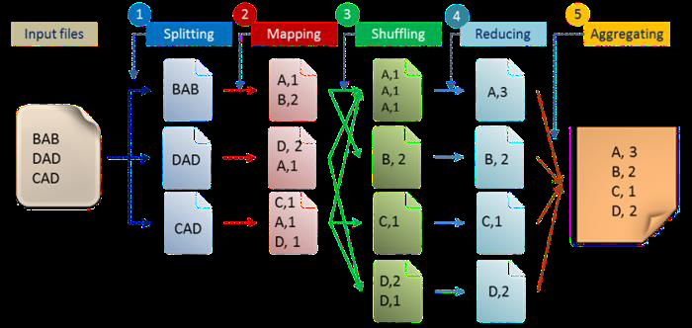
Five Steps MR – Programming Model
[1. Splitting, 2. Mapping (Distribution), 3. Shuffling and Storing, 4. Reducing (Parallelizing), 5. Aggregating]

Slide 48
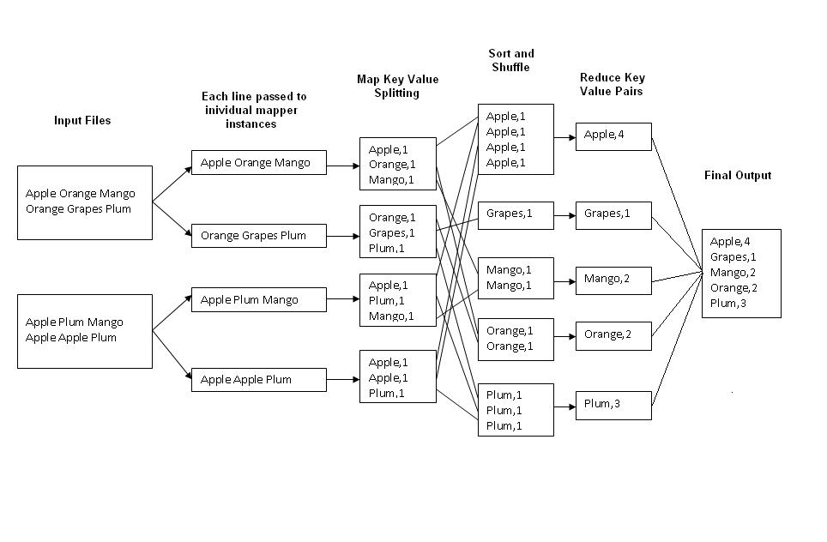
Map Reduce – Model

Slide 49
Architecture – BD on Analytics
MR Architecture
Fault Tolerance Graph Architecture
Streaming Graph Architecture

Slide 50
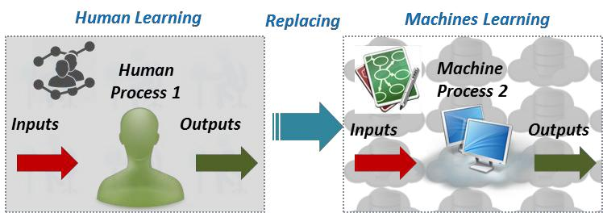
Replacing Human in Machine Learning Process

Slide 51
Major Techniques of ML - DM
Data Mining Process
Data Mining Techniques

Slide 52
Machine Learning
A core methodology in Data Analytics (DA) is Machine Learning (ML), is an area of computer science that aims to build a delivery systems and algorithms that learn from data.
The essence of ML is an automatic process of pattern recognition by a Learning Machine.
ML uses data to make any inferences or predictions to the specified tasks.
Historically, many terms to describe the equivalent meaning of ML, such as “Learning from data”, “Pattern Recognition”, “Data science”, “Data Mining”, “Text Mining” or even “Business Intelligence” and etc.
One of the Major techniques of ML is Data Mining
(DM –Looking for patterns of data), where
    Feature selection,
    Supervised learning (learning with labels),
    Unsupervised learning (without labels) and
    Deep learning (complex, mysterious and popular learning – able to identify features from raw data) / reinforcement learning or hybrid learning algorithms are utilized for the
    Purpose of ML tasks / methods like
      classification / clustering / association / regression / dimensionality reduction / batch-based collaborative filtering / decision-makings through decision trees.

Slide 53
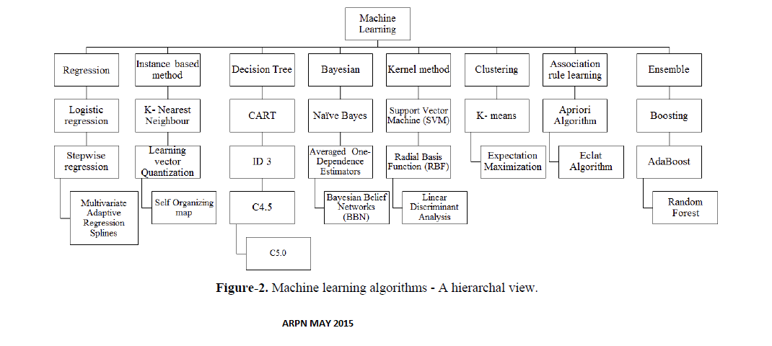
BD Supported -ML based Algorithms

Slide 54
BD Supported Languages
Python - Minimum codes
Scala
Java
R - For Statistical purpose - Visualization
Ruby and
Clojure
Note: Must thorough on Unix – shell commands
and SQL

Slide 55
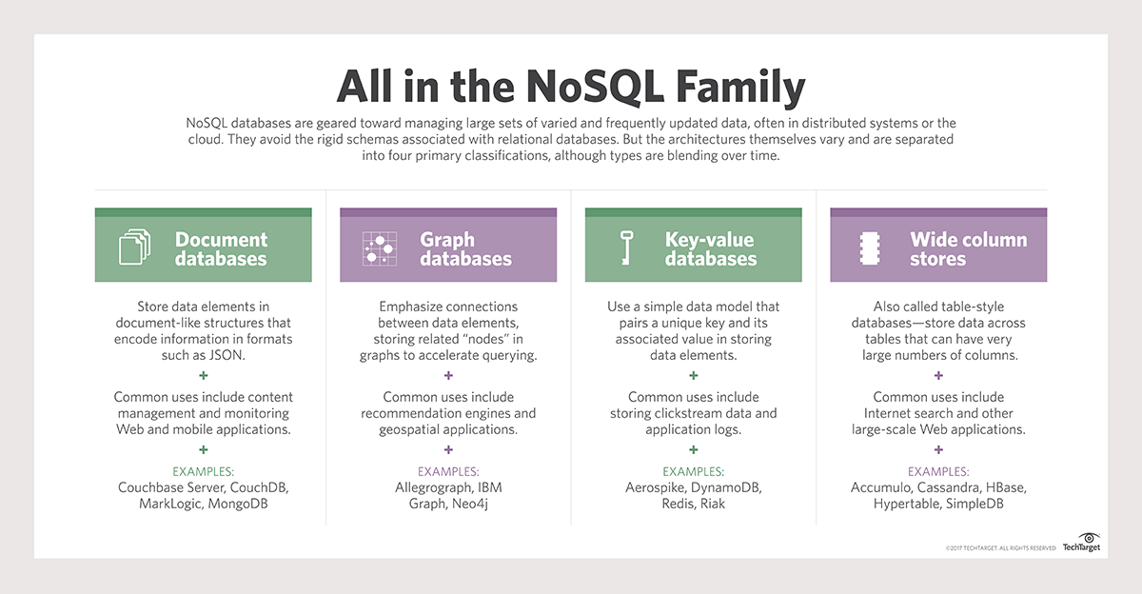
NOSQL (Not Only SQL) – Databases & its Examples
[Key-Value: Represent Data as a Collection of KV Pairs (known as Dictionary or Map)
Graph : Represent Data as a Network of nodes]

Slide 56
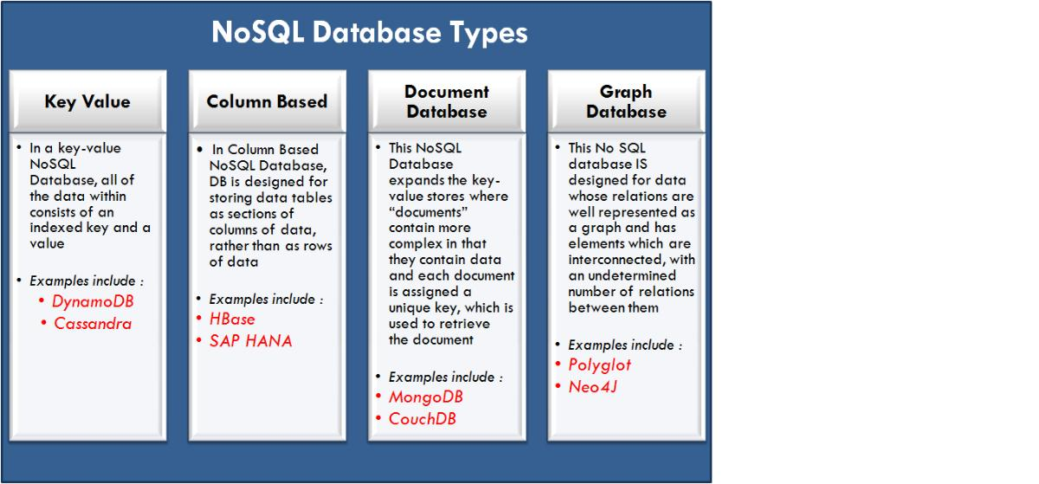
NOSQL - Types

Slide 57
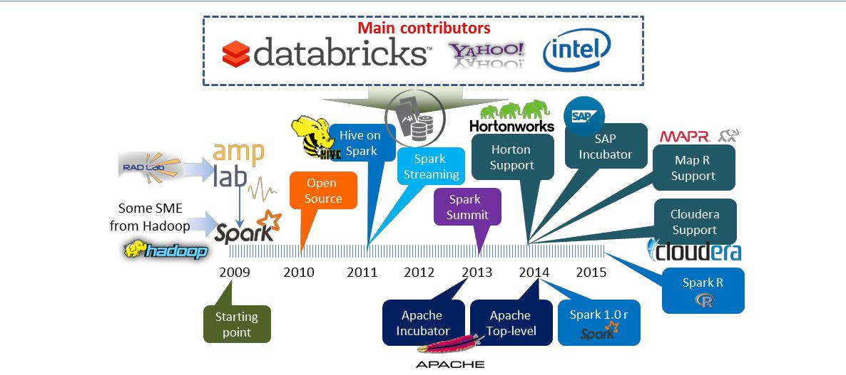
Spark – History

Slide 58
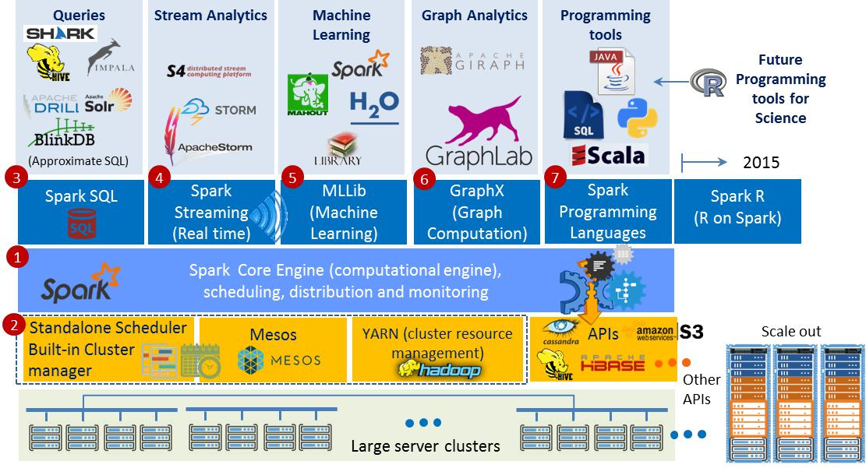
Spark Analytic - Stack

Slide 59
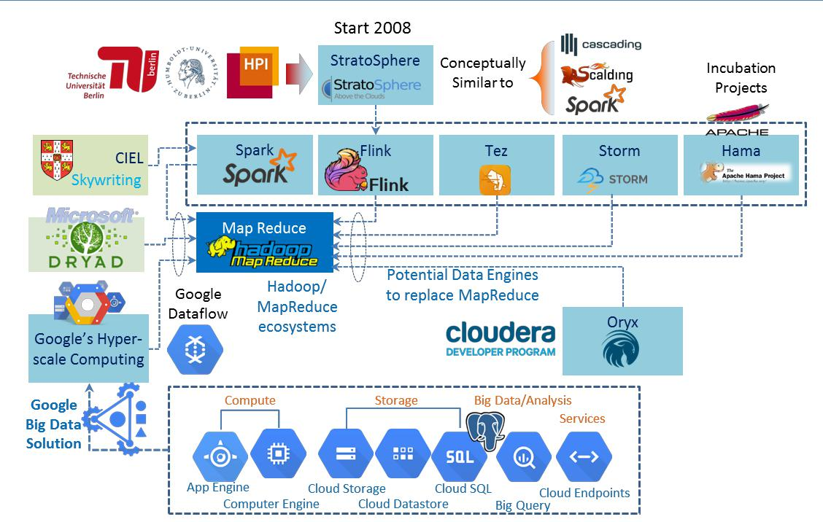
Potential data processing engines to replace MapReduce

Slide 60
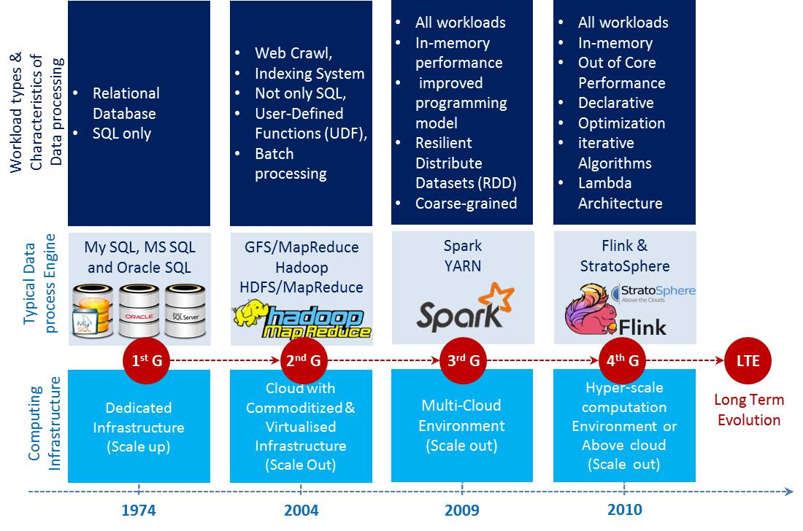
Evolution of Data and Big Data process engines

Slide 61
Computing Platforms
To analyze the massive data set in an effective manner, it is essential to have suitable hardware, software. i.e., we must have effective computing platforms, developing tools and algorithms.
Huge datasets are analyzed w.r.t data volume, band width of network used & different constraints of computations like End-User locations, algorithms / techniques used etc.,
Computational platforms for performing large data set analysis can be categorized into FOUR main models .
  Supercomputing
  Grid computing
  Cloud computing and
  Heterogeneous computing – Computer architecture that uses different types of computational processors such as GPP (General purpose processors) and GPU (Graphics Processing Unit)

Slide 62
Choosing a Platforms
Platforms based on Scaling:
  Horizontal Scaling (Scale-Out): Apache Hadoop, MR, Spark
  P to P Networks
  Vertical Scaling (Scale-Up): HPC clusters, Multi-core
  processors, GPU, FPGA, GPGPU
  Decision to be taken depends on
  Data Size
  Speed
  Throughput Optimization and
  Model Development

Slide 63
Typical Vendors in BD
MapR
Cloudera
Hortonworks
IBM
Teradata
Intel
AWS
Pivotal Software and
Microsoft

Slide 64
Major Industries Using BIG DATA
Healthcare
  Gene Sequencing, Bioinformatics, Pharmaceutical Research, Prediction of diseases
Banking
  Modeling true risks, Fraud Detection, Threat Analysis, Trade Surveillance, Credit Scoring and Analysis
Advertising
  Ad targeting, Recommendation Engine, Click Fraud Detection
Telecommunications
  Customer churn Prevention, Network Optimization, Calling data record analysis
Manufacturing
  Product Research, Engineering Analysis, Quality Analysis

Slide 65
Impact of BD Analytics in Health
Health BD Analytics can detect critical-clinical state-of-affairs to provide patients-wellness centric outcomes.
It will become a part of better solution-centric to predict epidemics, reduce preventable deaths by invoking proactive measures.
It explores the hidden behavioral patterns of people, controlling, escalating healthcare overheads and augment the QoL (Quality of Living) style to every patient.
According to a McKinsey report, big data analytics is the platform to deliver five values to healthcare: Right Living, Right Care, Right Provider, Right Value and Right Innovation.

Slide 66
Bio -Medical Big Data
It consists of molecule, cell structure and population data.
Bio medical data analytics is used to discover, development and delivery for personalized care.
Sharing in the bio-medical sciences can present sociological challenges.
Example:
    Data sharing in the neurosciences provides a valuable information

Slide 67
New Approach to Health BD Analytics
It can help in following areas:
  Clinical Treatments (Operations): Storage of healthcare data permits to perform analytics.
  Administration: Keeps track of all transactions records, EHRs data.
  Health Policy: Helps to governments to make decision on policy with respect to health, health budget.
  Clinical Research and Development: BDA will assist medical students to do research.
  Public health: To track infectious diseases outbreak, pattern analysis in improving public health.
  Patient Profile Analytics: To know about individuals health details.
  Device/Remote monitoring: Data from real time environment like CCTV footages.
  Outcome of clinical results/safety: During emergency & safety, access of patient’s record would assist.
  Fraud Detection: Fraudulent Insurance claim can be eliminated.

Slide 68
BD Technology Big Players in HC Applications
In Healthcare
    Diagnosis, Treatment and Re-admission are core applications areas in Health Care Analytics to probe the analysis
Technology Big Players
    Amazon
    Microsoft’s Health Vault
    Google, IBM’s Pure Data Solution-Diagnosis
    Watson Health-Super computer
    Watson Care Manager (WCM)-Treatment
    Piedmont Healthcare’s Patient First – CVD - Readmission

Slide 69
Examples of Big data analytics based applications
Text analytics
Web analytics
Multimedia analytics
Social analytics
Network analytics
Visual analytics
Genomic analytics and
Patient profile analytics

Slide 70
Identified Key issues in big data
Key issues identified in big data are
  Sufficient speed for large data size
  Familiarize the data
  Exploring data quality
  Displaying meaningful results

Slide 71
BD Applications – Promises of BD
Weather prediction
Medical diagnosis
Financial markets
Resource management
Computational social science
Smart buildings and cities

Slide 72
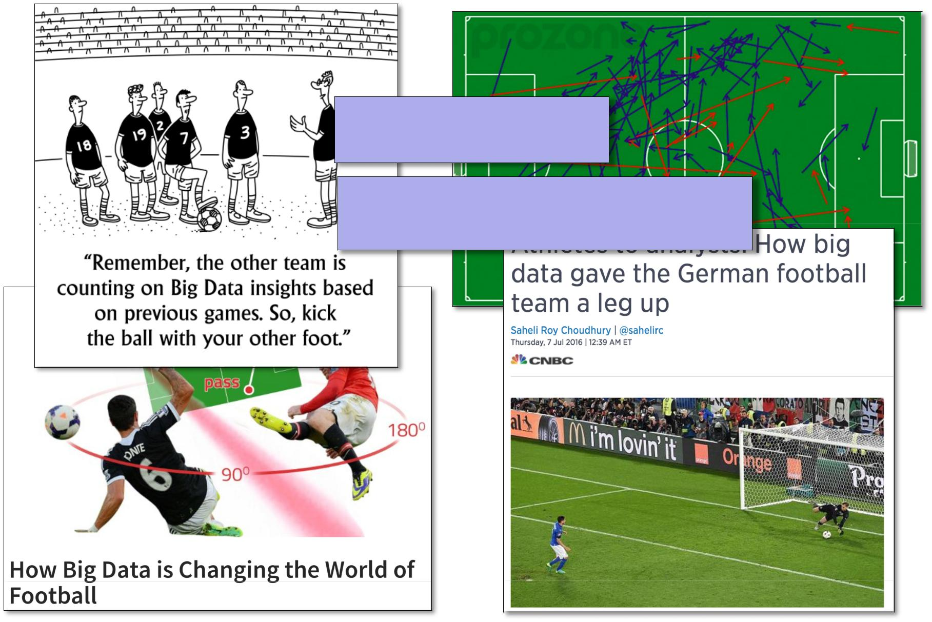
How BD has changed the world in Football
[Collect data, Do something with it]

Slide 73
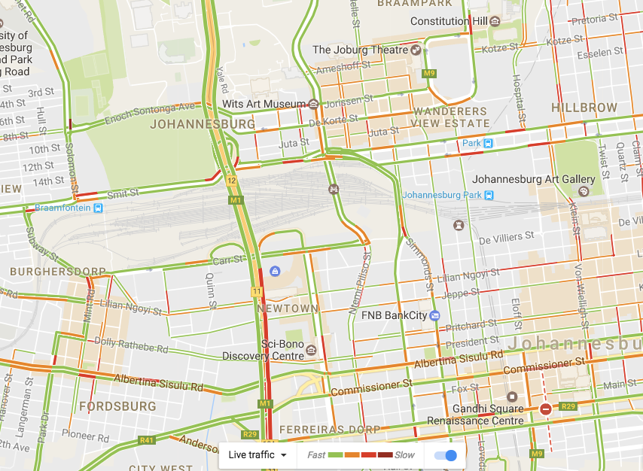
Eg., Promises of BD - Traffic Management
(1) Collect data
(2) Do something with it

Slide 74
Famous Sayings
Teachers are using their brain in 15%.
Students are using their brain in 40%.
Researchers are using their brain in 80%.
Best teacher teaches from heart and not from books.

Slide 75

Thank You

